Slide 1

Elo World Team: Jon, Ben, Eleanora & Shrawantee

Slide 2
Elo Merchant Category Recommendation
Elo, one of the largest payment brands in Brazil, has built partnerships with merchants in order to offer promotions or discounts to cardholders.
For these promotions to work for either the consumer or the merchant, Elo has built machine learning models to understand the most important aspects and preferences in their customers’ lifecycle, from food to shopping.
But so far none of them is specifically tailored for an individual or profile.
We attempt to develop algorithms to identify and serve the most relevant opportunities to individuals, by uncovering signal in customer loyalty.

Slide 3
So, what are we predicting?
A loyalty score (target) for each customer (card_id) represented in datafiles: “test.csv”, ”sample_submission.csv”, etc.
Some of our variables of interest:
target: loyalty numerical score calculated 2 months after historical and evaluation period
feature_1, feature_2, feature_3: Anonymized card categorical feature
first_active_month: ''YYYY-MM', month of first purchase

Slide 4
Flow of the presentation
Description of the data
Pipelining the data
Algorithms
Lasso, Random Forest, Logistic Regression, Neural Network, LGBM (Light Gradient Boosting Machine), Multivariate Linear Regression
Final thoughts

Slide 5
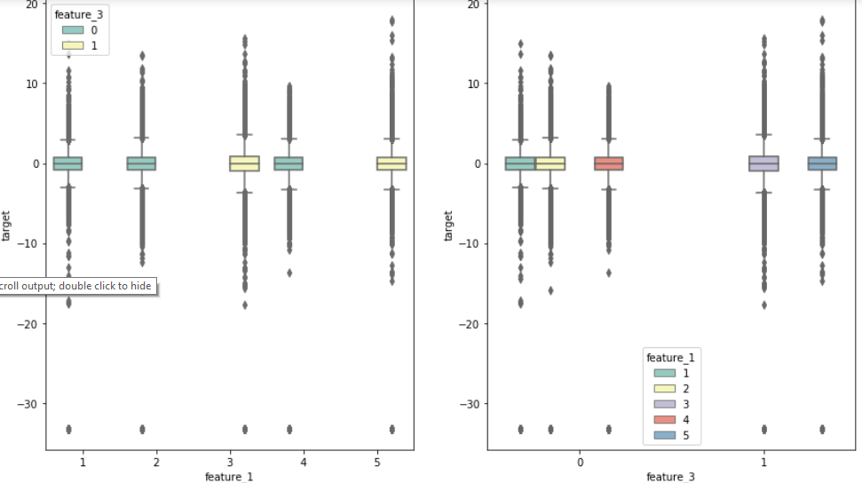
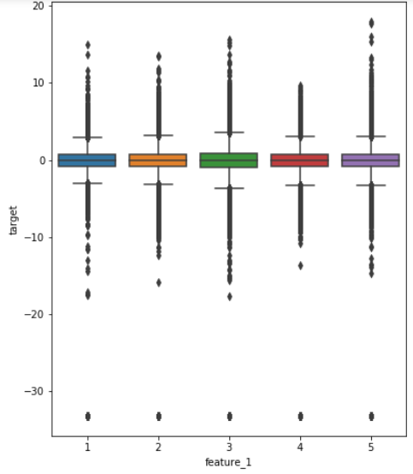
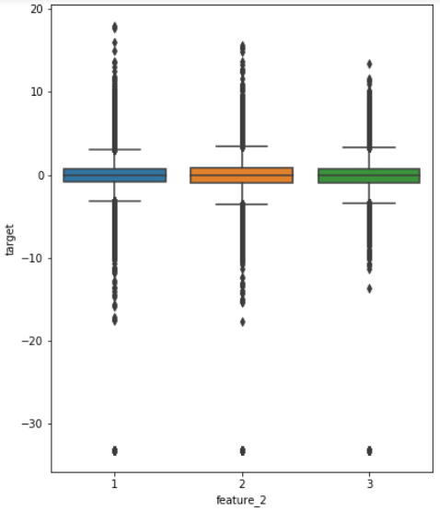
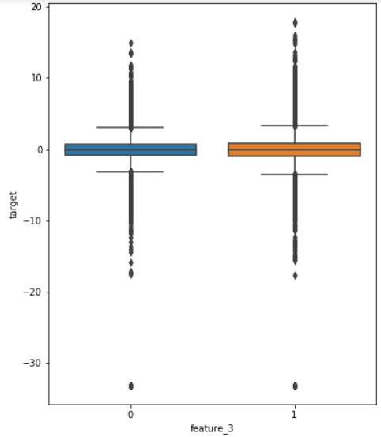
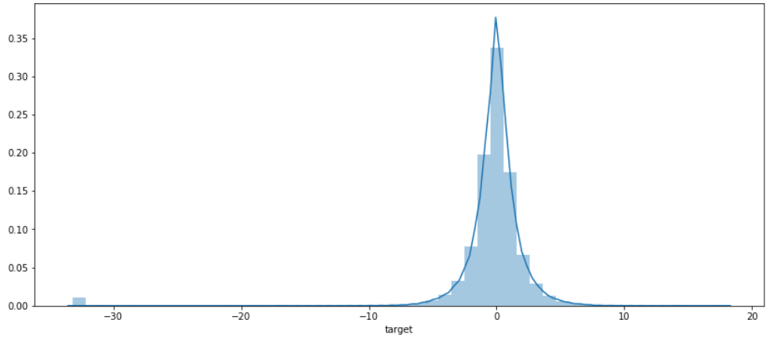
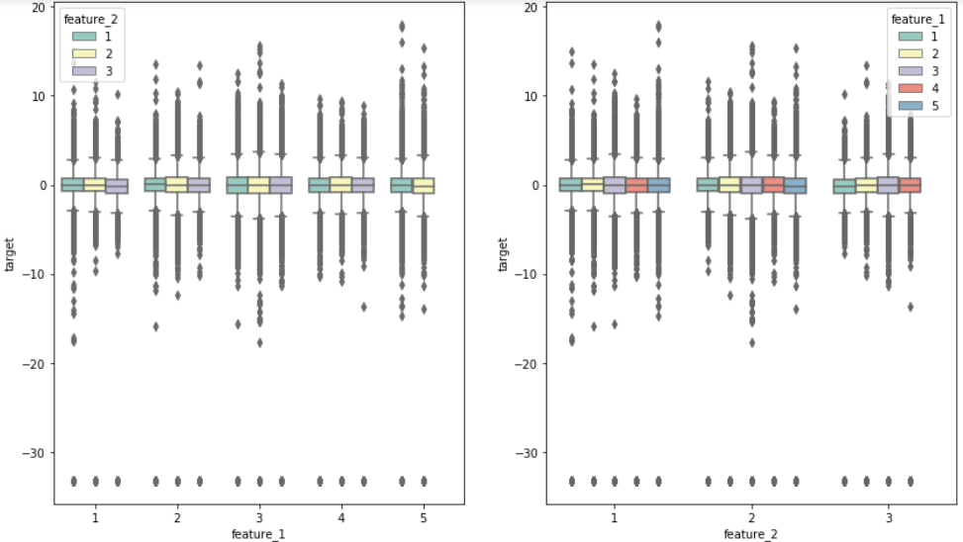
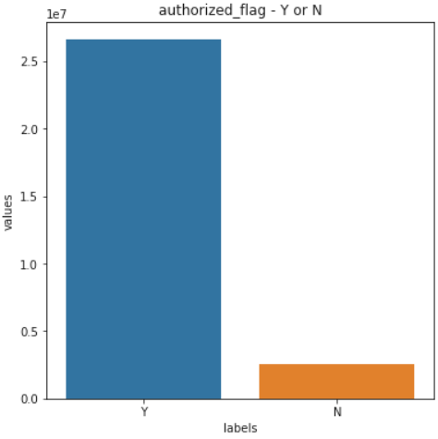
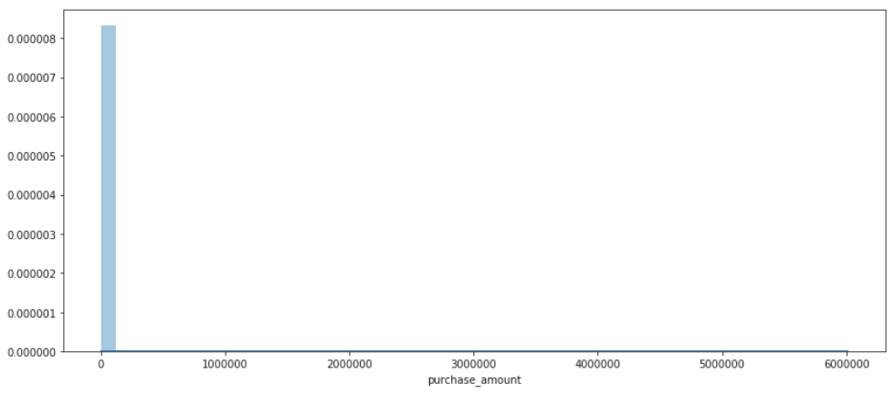
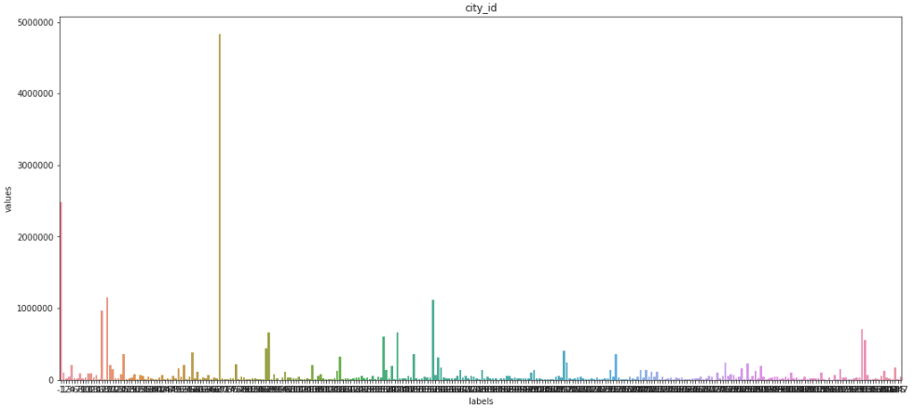
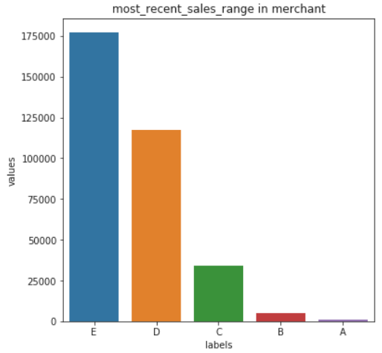
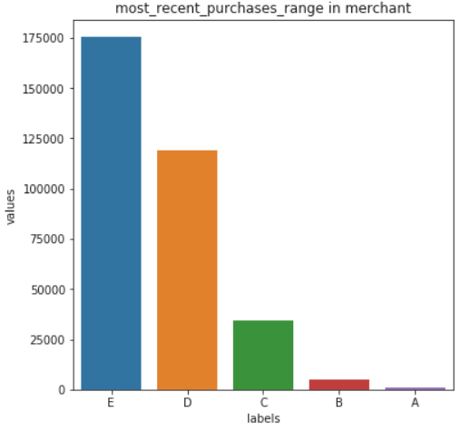
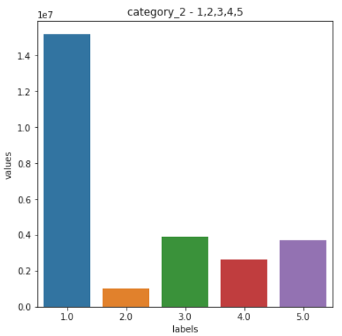
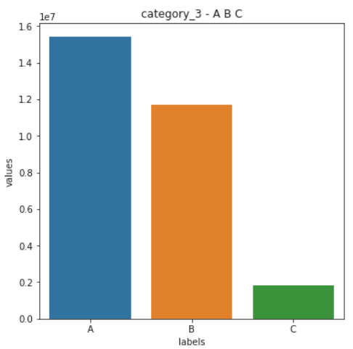
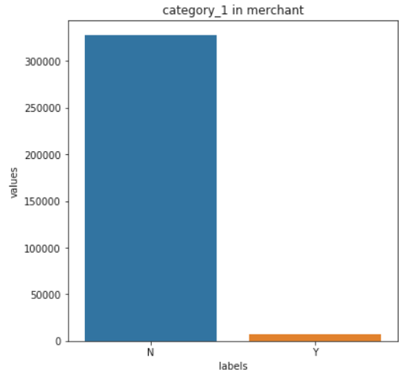
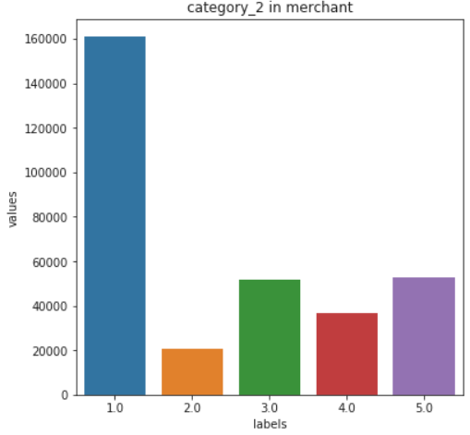
Raw Data Distribution.
In Train file:
Target Distribution
Features Distribution of Target
In Historical Transactions File:
In Merchant file:
Authorized Flag Distribution
Purchase Amount Distribution
City ID Distribution
Recent Sales/Purchase Range
Distribution.
Category 2 &3 Distribution
Category 1 & 2 Distribution

Slide 6
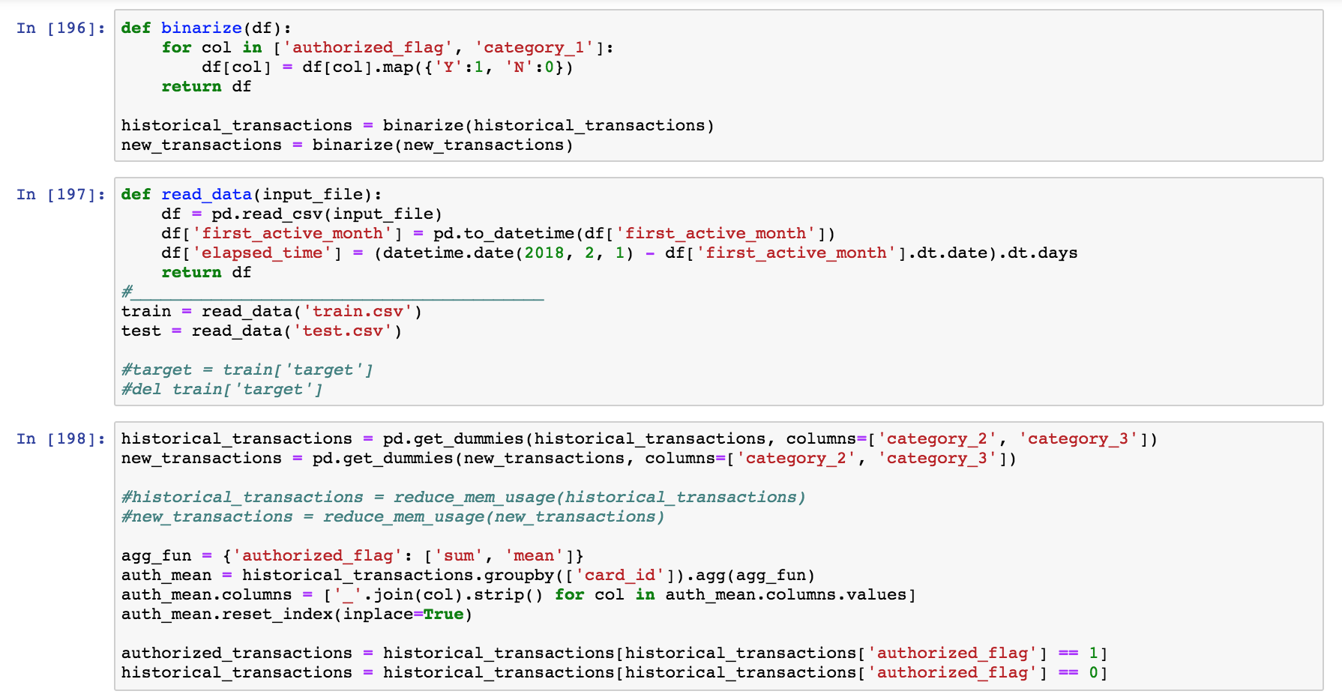
Pipelining
Convert no and yes to 0 and 1
Convert “first_active_month” to an integer value
One-hot-encoding of categorical data

Slide 7
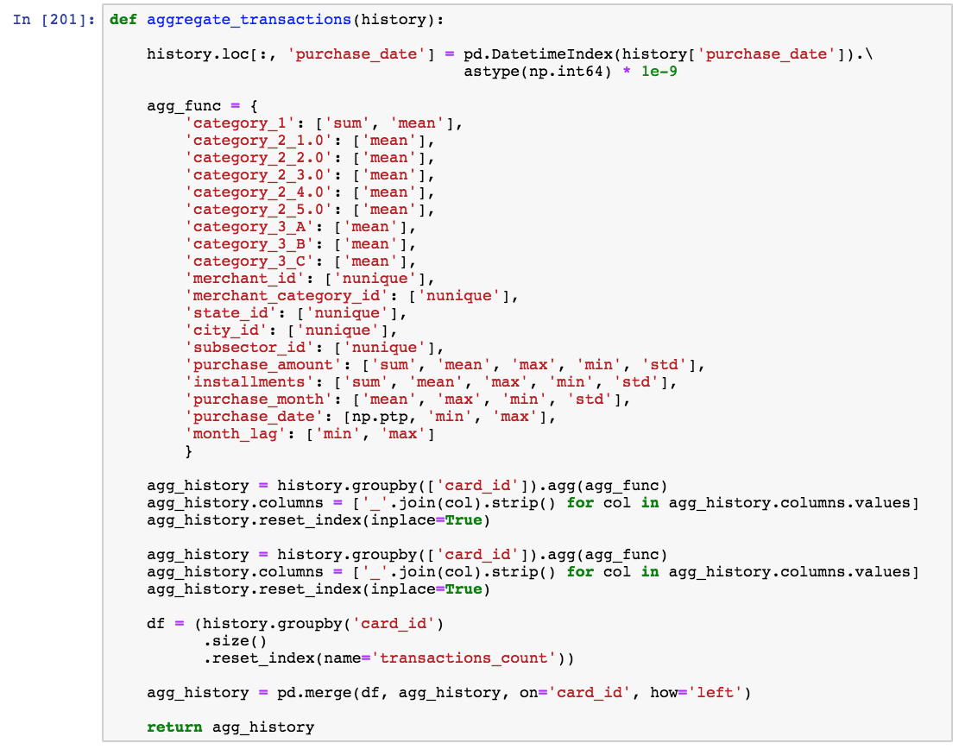
Pipelining (continued)
Grouping transaction data by card ID to
extract information on each card user:
- Average, max, median, std for continuous variables
- For categorical variables the averages provide frequency related information

Slide 8
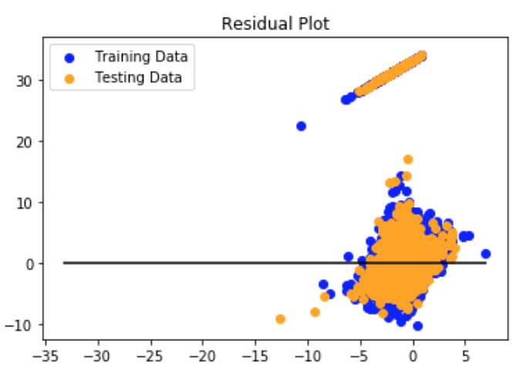
Linear Regression
RMSE:12.813; R²: 0.05161

Slide 9
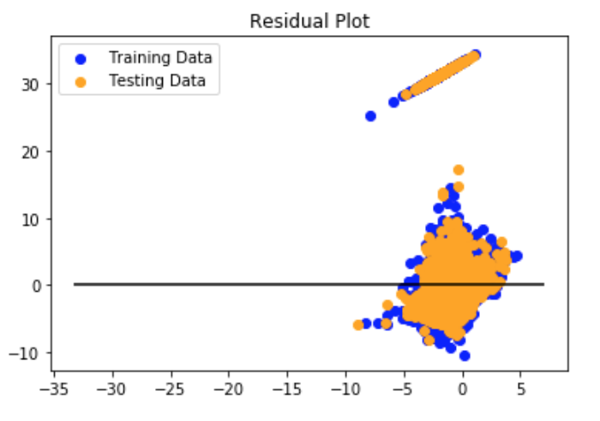
Lasso
RMSE:12.83; R²: 0.05001

Slide 10
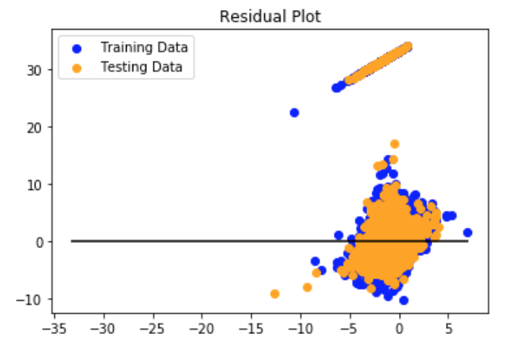
Ridge
RMSE:12.61; R²: 0.06651

Slide 11
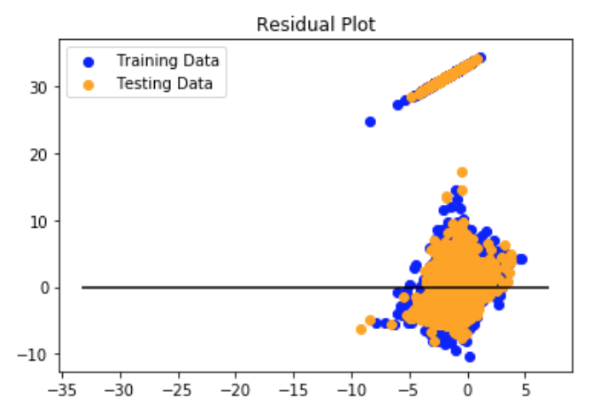
ElasticNet
RMSE:12.82; R²: 0.0508

Slide 12
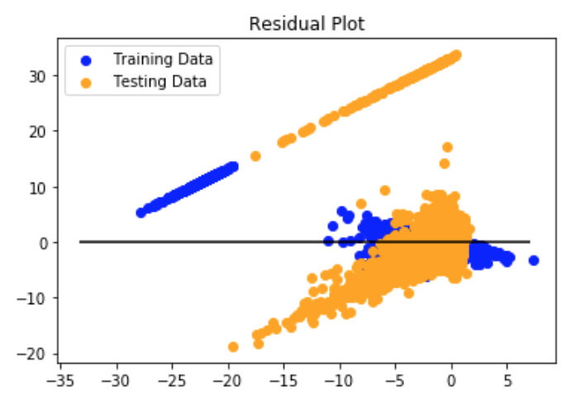
Random Forest
RMSE:12.61; R²: 0.06651

Slide 13
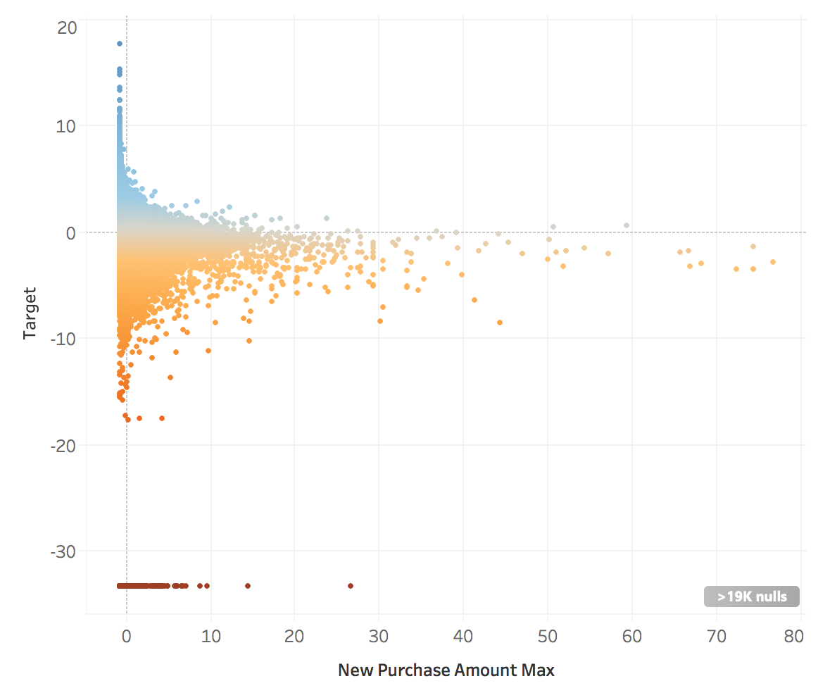
Logistic Regression

Slide 14
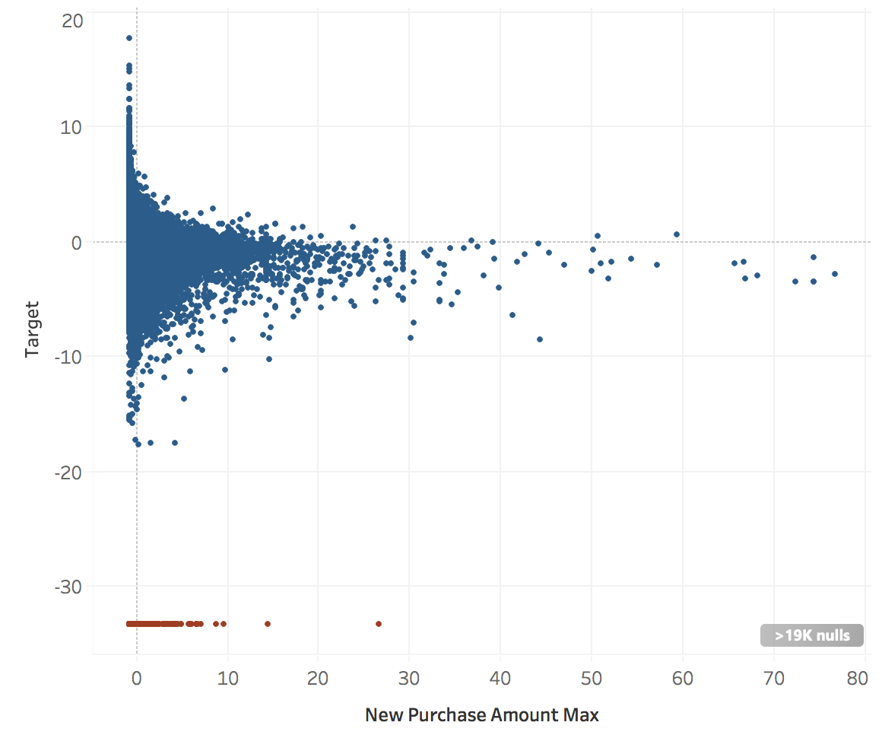
Logistic Regression
Normal loyalty
Extremely disloyal

Slide 15
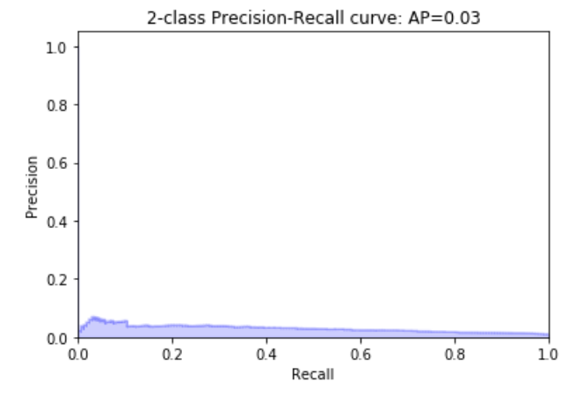
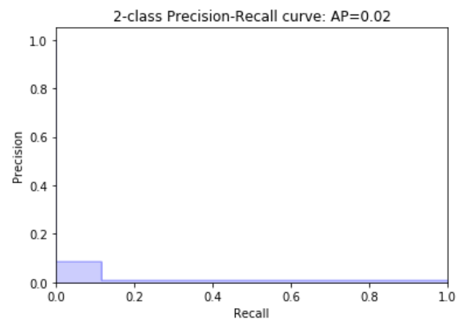
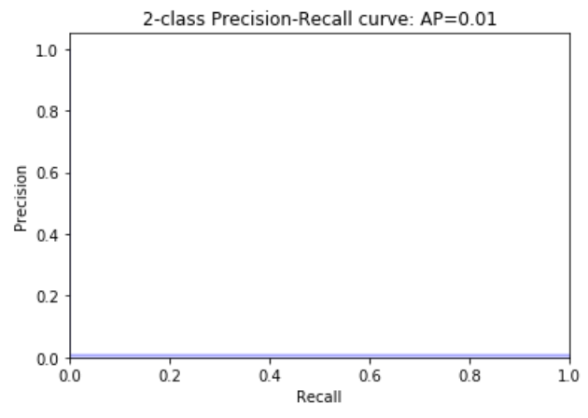
Logistic Regression
Decision Tree
Random Forest

Slide 16

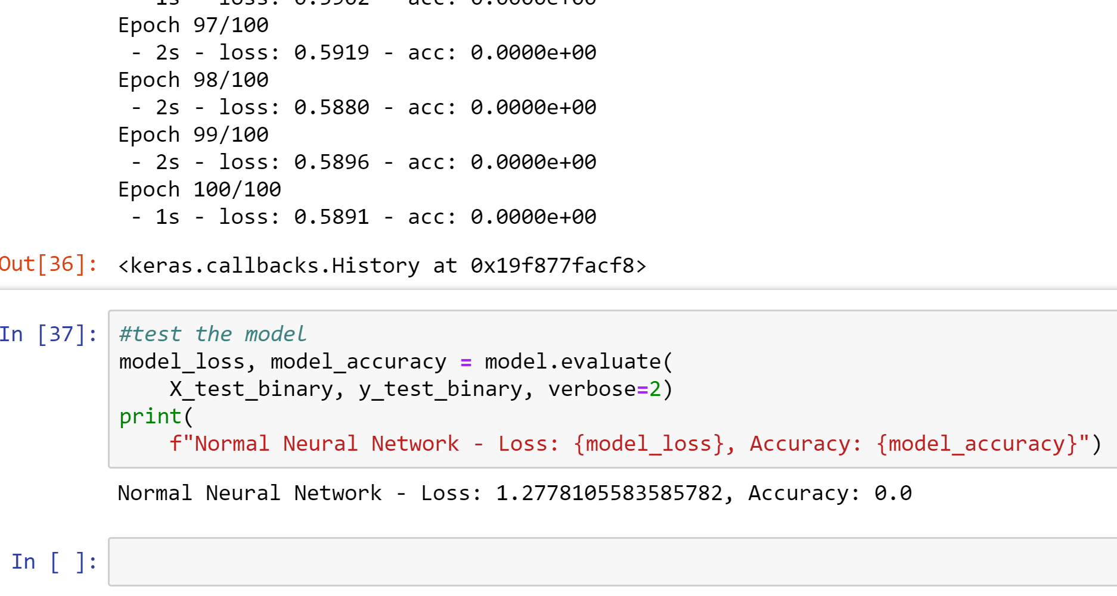
Neural Network
Encountered many issues with data as it was, so we needed to narrow down the important columns
Binned target results based on “Loyal” and “Disloyal” scores
Scaled data to range between 1 and 0
Did a principal component analysis to determine most variance in the data and to make network easier to run, picked 50 columns that accounted for 95% of variance.
Ran Neural Network, achieved a accuracy of 0.
Conclusion:
This is a complex dataset that may require multiple kinds of models working in synchrony to make accurate predictions.

Slide 17
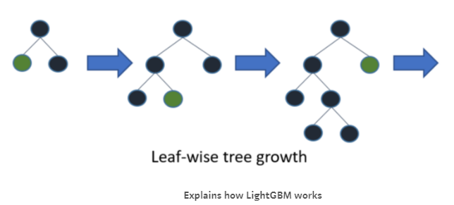

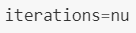
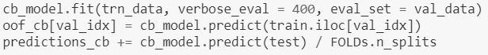
LGBM (Light Gradient Boosting Machine)
Light GBM grows tree vertically while other algorithm
grows trees horizontally meaning that Light GBM grows
tree leaf-wise while other algorithm grows level-wise.
CatBoost is a fast, scalable,
high performance open-source
gradient boosting on decision
trees library.

Slide 18
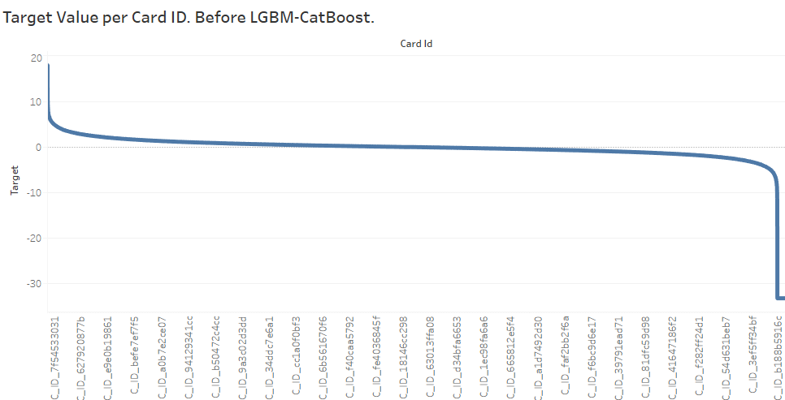
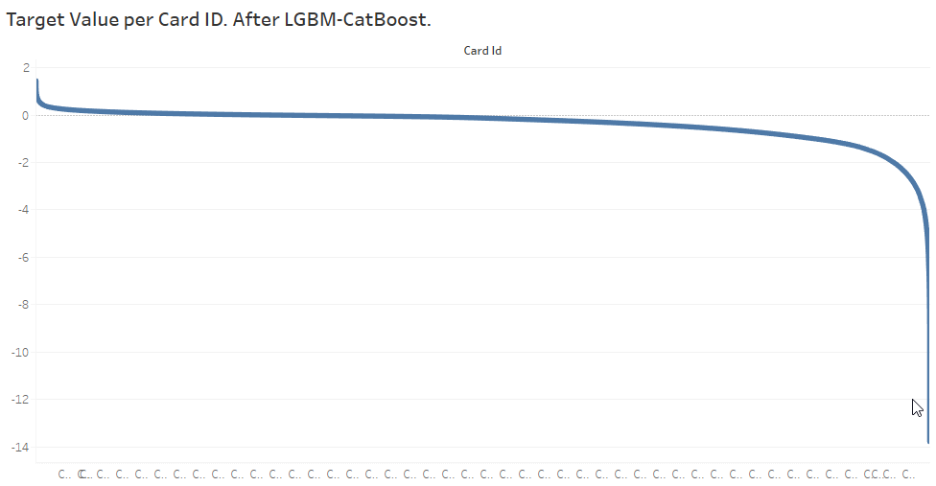
LGBM & Cat Boost (cont…)
Target level +18 to -35 before LGBM/CB.
Target level +2 to -14 after LGBM/CB.

Slide 19
Multivariate Linear Regression

Slide 20
Multivariate Linear Regression

Slide 21
Multivariate Linear Regression

Slide 22

Multivariate Linear Regression

Slide 23
Final thoughts…
All measures of R-squared across different algorithms are low.
Low R-squared in not inherently bad, and it is not surprising.
We are trying to analyzing human behavior which is simply harder to predict.
Moreover, what is more important is the we can still draw important conclusions about how changes in the predictor values are associated with changes in the loyalty scores. This is extremely valuable information.
Additionally, there were challenges with the data. With most variables being anonymized, we could not explore meaningful interactions between the variables.

Slide 24

Good Luck!!!

